Slide 1
GROCERY BASKET
ANALYSIS
By pragati pawar

Slide 2
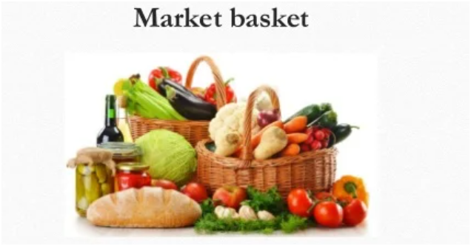
Objective
To analyze grocery transactions and uncover associations between commonly purchased items using the Apriori algorithm.
analyze the Instacart dataset by sampling 100,000 and more transactions and focusing on the top 35 most frequently purchased items.
01

Slide 3
Libraries
02
03
01
Pandas
Matplotlib
Seaborn
02

Slide 4
Used CSVs:
orders.csv
order_products__prior.csv,
products.csv,
departments.csv
Dataset Summary
Total rows analyzed: Over 10 lakh
03

Slide 5

Apriori Algorithms
Apriori is an algorithm used to find
frequent itemsets and generate association rules from transactional data.
Apriori helps us discover this kind of shopping pattern.
Support : How often item(s) appear in data
Confidence: How often rule is correct (A → B)
Lift: How much A increases the chance of B
04

Slide 6
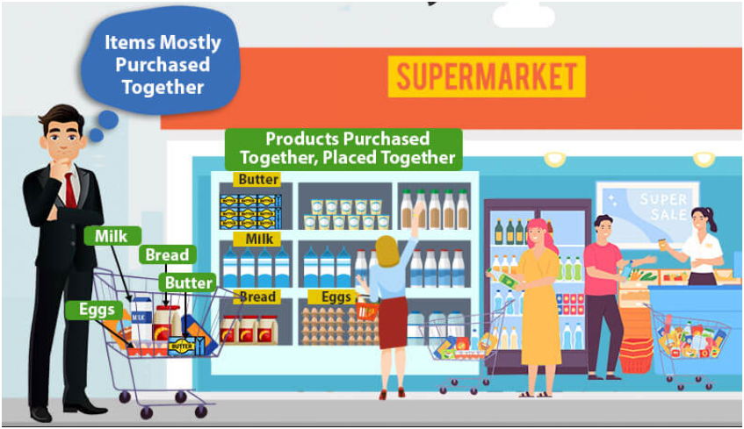
Top Insights
Most ordered product: Bananas
Organic products are highly popular
Peak order time: 10 AM – 2 PM
Most active day: Sunday
Customers reorder the same items often
Departments like Produce and Dairy dominate
Most users buy 5–10 products per order
Some products are often bought together (e.g., bananas + strawberries)
05

Slide 7
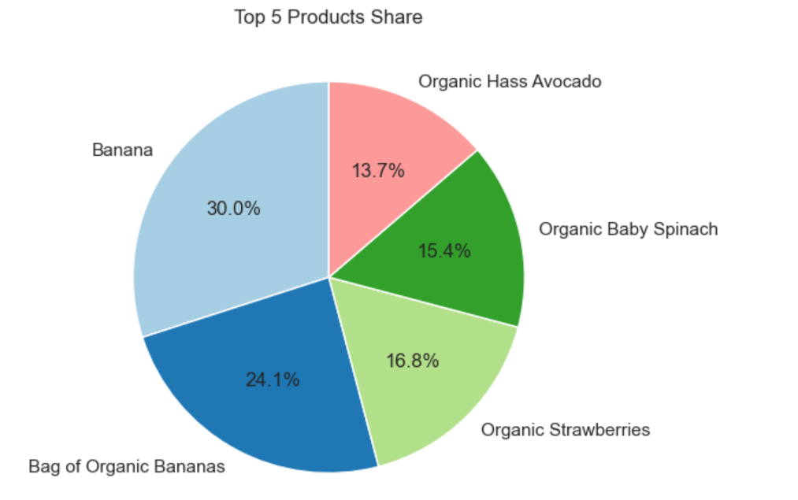
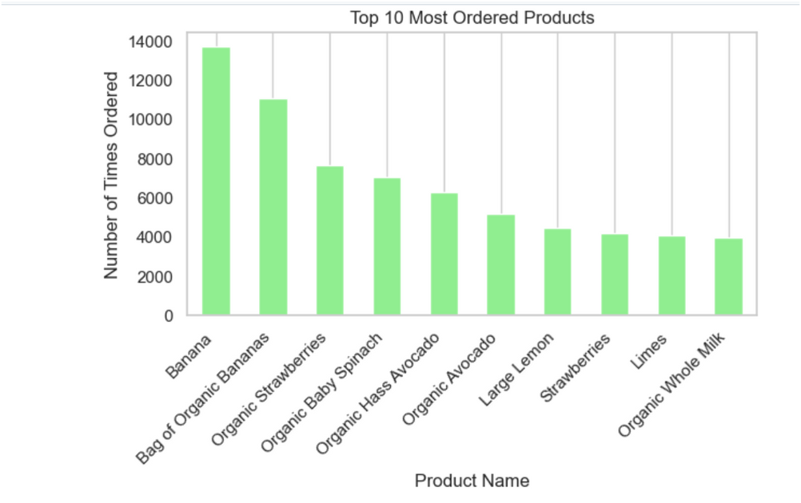
Visualizations
Bar Chart
pie Chart
06

Slide 8
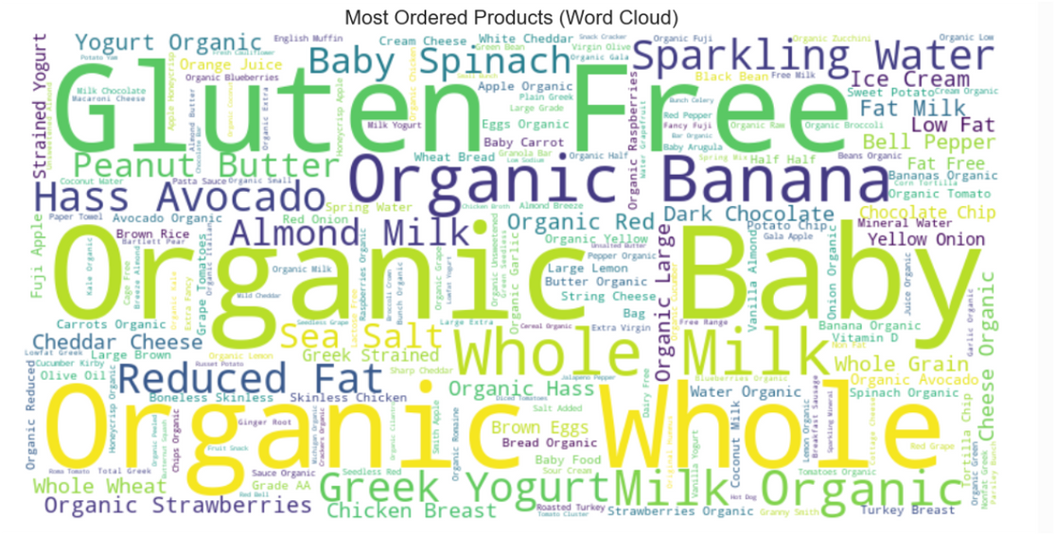
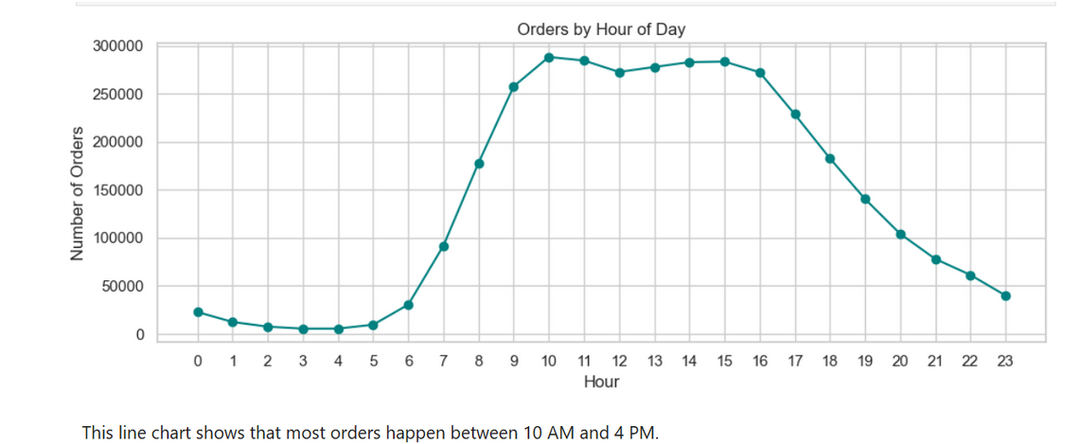
Visualizations
Line Chart
Word cloud
06

Slide 9

Data Challenges
RAM limit → Sampled large files
Some missing values
Needed column merging from multiple CSVs
Performance optimization
07
www.reallygreatsite.com

Slide 10
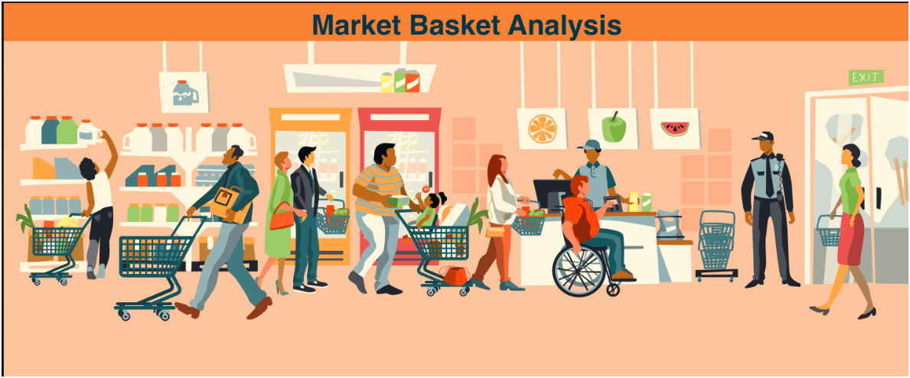
Conclusion
Customer buying behavior is predictable: users frequently reorder the same products, shop mostly in the mornings and on weekends, and often include daily essentials like milk and eggs in their carts. These insights help improve product recommendations, manage stock efficiently, and design better combo offers.
The project used real, large-scale Instacart data (32M+ rows), and a simplified, filtered approach was applied to handle processing on a 4GB system while still generating 25+ meaningful insights using Python and Jupyter Notebook.
08

Slide 11
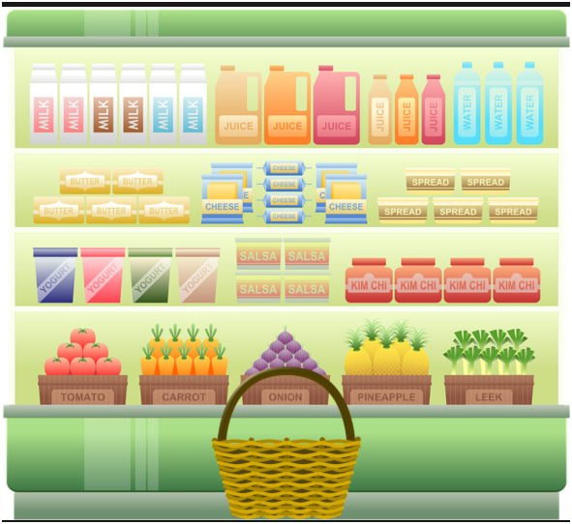
Thankyou
09

